Slide 1
ACN – Term project
SDN-IoT
Group Members:
Aman Sirohi CB.EN.U4AIE21003
R Sriviswa CB.EN.U4AIE21046
Rakhil ML CB.EN.U4AIE21048
Vikhyat Bansal CB.EN.U4AIE21076

Slide 2
INTRODUCTION
The fusion of Software-Defined Networking (SDN) and the Internet of Things (IoT) holds tremendous potential to revolutionize interconnected devices. Acting as a conductor in a symphony, SDN ensures seamless communication among smart devices. This project aims to bridge theory and practice through theoretical exploration, simulations, and real-world experiments. Successful integration could lead to a future where smart devices communicate effortlessly, enhancing efficiency. This journey at the crossroads of SDN and IoT has the power to redefine our interconnected world, ushering in an era of intelligent and responsive technological ecosystems.

Slide 3
Problem Statement
To improve security in SDN-enabled IoT Networks with respect to Confidentiality protection and Integrity verification.

Slide 4
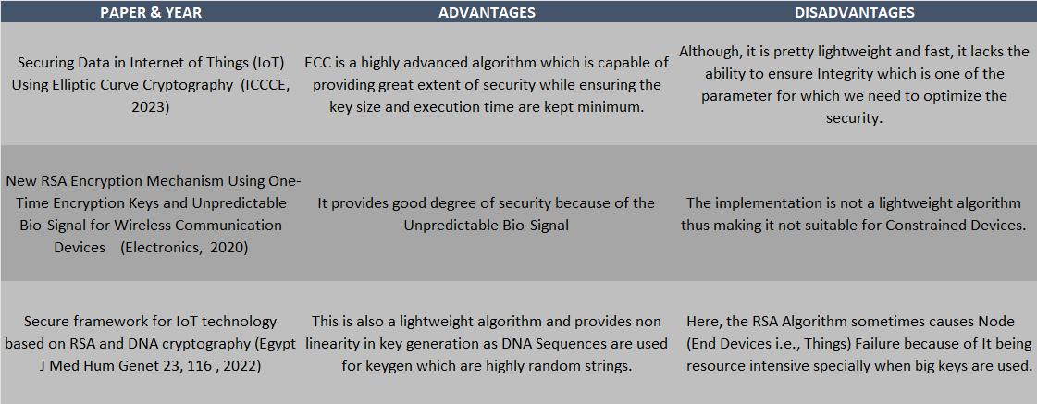
Related work

Slide 5
Proposed METHODOLOGY
Lightweight Cryptographic Algorithm :
A lightweight cryptographic algorithm is a type of cryptographic algorithm specifically designed to be computationally efficient and require minimal resources, making it suitable for implementation on resource-constrained devices such as IoT (Internet of Things) devices, RFID tags, wireless sensor nodes, and other embedded systems. The term "lightweight" emphasizes the need for reduced computational complexity, memory usage, and energy consumption without compromising the security of the cryptographic operations.

Slide 6
Proposed METHODOLOGY(cont.)
Benefits :
Low Computational Complexity and Fast Execution: Lightweight algorithms are designed to have minimal computational overhead. This ensures that they can be efficiently executed on devices with limited processing power in less time.
Energy-Efficient: Lightweight algorithms are optimized for energy efficiency, a critical consideration for battery-powered devices and systems where energy consumption is a limiting factor.
Commonly used Lightweight Encryption Algorithm examples are:
  Lightweight Block Ciphers: Such as PRESENT, SIMON, and SPECK.
  Lightweight Hash Functions: Such as Keccak (and its derivative SHA-3) with a reduced number of rounds.

Slide 7
IMPLEMENTATION
Key Generation:
The SDN controller generates an ECC (Elliptic Curve Cryptography) key pair (public and private keys) of size 256-bit (provides similar degree of security as RSA does for 2048-bit Keys) for each IoT device.
The private ECC key is securely transmitted to the respective IoT device over a Secure channel.
    This can be ensured using DTLS (Datagram TLS) or some Secure-Key Exchange Protocol such as Datagram-based Key Exchange (DAKE) as TLS can't be used with UDP, but these methods would allow for connectionless exchange of keys.
The ECC public keys are distributed to devices and controller.

Slide 8
Encryption:
Multiple 128-bit session keys (K₁, K₂, K₃...) are generated randomly by the SDN controller.
The session keys are encrypted using the receiver's ECC public key.
The encrypted session keys packet is sent to the receiver.
The plaintext is divided into blocks of 128-bits P₁, P₂, P₃..
For each block P_{i}:
    a) Generate a random 128-bit Initialization Vector (IV_{i})
    b) Choose session key K_{j} randomly
  c) Compute C_{i} = AES-128-CTR-Encrypt(P_{i} ⊕ IV_{i}, K_{j}, IV_{i})
    [IV_{i} is used to XOR the plaintext]
    [In AES-128 (Advanced Encryption Standard with a key size of 128 bits) in CTR (Counter) mode, each block of plaintext is encrypted independently, allowing for parallelization and efficient processing.]
    d) The {IV_{i} + Ciphertext (C_{i}) + K_{i}} block is signed with sender's ECC private key using ECDSA( Elliptic Curve Digital Signature Algorithm)
The signed and encrypted blocks are concatenated into the full ciphertext which is sent to the receiver.

Slide 9
Decryption:
Digital Signature Verification and Private Key Usage:
The receiver decrypts the session keys packet with its ECC Private Key.
It verifies the digital signature of the block using Sender's Public Key. This ensures the integrity and authenticity of the encrypted blocks.
It simultaneously extracts IV_{i}, C_{i} and K_{i} for the block.
The block is decrypted with AES-128 in CTR mode using the saved K_{i} and IV_{i} to recover the original plaintext block.
Steps 2-4 are repeated to decrypt all blocks.
Reconstruction:
The decrypted blocks are concatenated to reconstruct the full original plaintext message.

Slide 10
Tools identified
CrypTool 2 (CT2): It is a better version of CTO which visualizes cryptography and cryptanalysis. It includes not only the encryption and cryptanalysis of ciphers, but also their basics and the whole spectrum of modern cryptography with over 200 ready-to-use templates with workflows. We can also easily combine and execute cryptographic functions to create workflows in CT2 by ourselves (visual programming). With this approach, complex processes can be easily visualized and thus better understood.
Cryptol (The Language of Cryptography): Cryptol is a domain-specific language for specifying cryptographic algorithms. A Cryptol implementation of an algorithm resembles its mathematical specification more closely than an implementation in a general-purpose language.
GNS3: Graphical Network Simulator for simulating network topologies and protocols. Allows integrating custom programs for encryption simulation.
Notes:
Deploying AES on CrypTool 2
PDF related to Tools

Slide 11
Conclusion
I have implemented a unique Lightweight Encryption Algorithm that is efficient and feasible to be used for SDN-enabled IoT Networks.
It isn't just lightweight and fast, but provided a great deal of security as well since backtracking in ECC is still one of the most complex tasks with very low success rate.
And I have also used ECDSA to ensure Integrity is maintained, as in, if someone intercept the traffic and then retrieve the data, our network will catch on to any alterations in the data since Digital Signature wouldn't be verified at the Receiver's End. This kind of integrity is highly important in IoT Networks used in Healthcare, Defence and Research Organizations etc.

Slide 12
FUTURE DIRECTION
I have implemented an algorithm which offers even greater security and ensures integrity in SDN-based IoT Networks but the reason I didn't present it here is that there is no benchmark as to how much computation power would an End Device hold and I had doubts if my algorithm would work for almost all the IoT Constrained Devices or not.
As for future scope, I would try to incorporate some methodology to induce more non-linearity in my key generation and would try to use Hashing Functions as well. And my goal is to extend this to a Conference Paper.

Slide 13
References
Sufian Hameed, Faraz Idris Khan, Bilal Hameed, "Understanding Security Requirements and Challenges in Internet of Things (IoT): A Review", Journal of Computer Networks and Communications, vol. 2019, Article ID 9629381, 14 pages, 2019. https://doi.org/10.1155/2019/9629381
Mohamed Litoussi, Nabil Kannouf, Khalid El Makkaoui, Abdellah Ezzati, Mohamed Fartitchou, "IoT security: challenges and countermeasures", Procedia Computer Science, Volume 177, 2020, Pages 503-508, ISSN 1877-0509, https://doi.org/10.1016/j.procs.2020.10.069.
R. Aiyshwariya Devi, A.R. Arunachalam, "Enhancement of IoT device security using an Improved Elliptic Curve Cryptography algorithm and malware detection utilizing deep LSTM", High-Confidence Computing, Volume 3, Issue 2, 2023, 100117, ISSN 2667-2952, https://doi.org/10.1016/j.hcc.2023.100117.
https://csrc.nist.gov/projects/lightweight-cryptography/finalists

Slide 14
Problem Statement
To improve QoS parameter such as latency, load balancing, bandwidth and real time decision in networks based on edge computing based SDN-IoT.

Slide 15
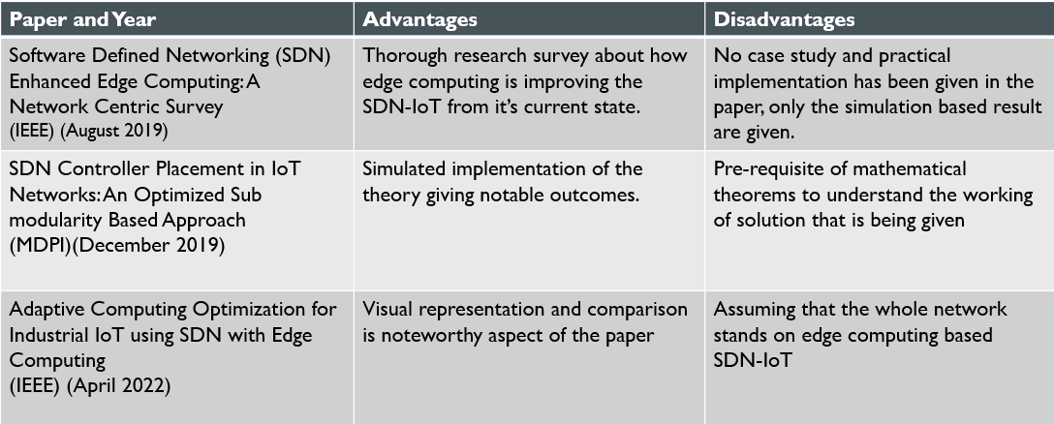
Related work
Notes:
https://ieeexplore.ieee.org/ielaam/5/8789751/8789826-aam.pdf
https://www.mdpi.com/1424-8220/19/24/5474
https://ieeexplore.ieee.org/document/9754048

Slide 16
Proposed Solution
Deep Reinforcement Learning integrated in Edge Computing based SDN-IoT
The integration of Deep Reinforcement Learning (DRL) in Edge Computing-based
Software-Defined Networking for the Internet of Things (SDN-IoT) is an idea that holds promise for optimizing resource management, improving decision-making, and enhancing the overall performance of IoT networks.
DRL algorithms can be applied to optimize the allocation of computing resources at the edge, ensuring efficient processing of IoT data while minimizing latency.
The agent learns over time to dynamically allocate resources based on the changing needs of IoT devices and the current state of the network.
DRL can contribute to dynamic traffic management by adapting routing decisions based on changing network conditions and demands from IoT devices.
The agent learns policies that improve the overall efficiency of data flow, reducing congestion and optimizing response times.
Notes:
https://jwcn-eurasipjournals.springeropen.com/articles/10.1186/s13638-023-02314-8

Slide 17
Proposed Solution (CONT.)
BENEFITS:
Reduced Latency:
Edge Processing: By performing deep learning tasks directly on the edge computing nodes, data processing occurs closer to the source of data generation. This significantly reduces the round-trip time to a centralized data center, resulting in lower latency and faster response times.
Bandwidth Optimization:
Local Data Processing: Edge computing enables local processing of data, reducing the need to transmit large volumes of raw data to a central server. Only relevant information or processed results may be sent, leading to efficient bandwidth usage and reduced network congestion.
Real-time Decision-Making:
Immediate Responses: Deep learning models running on edge devices can make real-time decisions without relying on cloud-based processing. This is critical for applications requiring instant responses, such as autonomous vehicles, industrial automation, or augmented reality.

Slide 18
Proposed Solution (CONT.)
BENEFITS:
Privacy and Security:
On-Device Processing: Edge computing allows sensitive data to be processed locally on the device, enhancing privacy by minimizing the need to send private information to a remote server. This is particularly important for applications dealing with personal or sensitive data.
Offline Operation:
Operational Independence: Edge devices equipped with deep learning models can continue to function even when disconnected from the central server or cloud.
Cost Savings:
Reduced Cloud Costs: Offloading processing tasks to edge devices can lead to cost savings by reducing the amount of data transferred to the cloud and minimizing the computational load on cloud servers.

Slide 19
Proposed Solution(cont.)
WORKING {Implementing DRL on edge nodes}
Select Appropriate Edge Devices: Choose edge devices with sufficient computational power and memory to handle deep learning tasks.
Install Deep Learning Frameworks: Install deep learning frameworks suitable for edge computing on the selected devices.
Model Optimization: Optimize deep learning models for deployment on edge devices. Techniques such as model quantization, which reduces the precision of model parameters, and model pruning, which removes unnecessary weights, can help minimize the model size and improve inference speed on edge devices.
Edge Node Integration with SDN: Ensure that edge nodes are integrated into the SDN architecture. SDN controllers play a crucial role in orchestrating communication and resource allocation.
Real-time Inference: Design the deep learning model and associated software to support real-time inference on the edge.
Edge-to-Cloud Offloading: Implement an DRL for deciding when to offload processing tasks to the cloud and when to perform them at the edge. Offloading less time-sensitive tasks to the cloud can help balance the computational load and ensure optimal performance.
Edge-to-Edge Collaboration: Explore collaborative learning approaches where edge nodes can share knowledge and update models collectively. This can be useful in scenarios where multiple edge nodes collectively contribute to improving model accuracy.

Slide 20
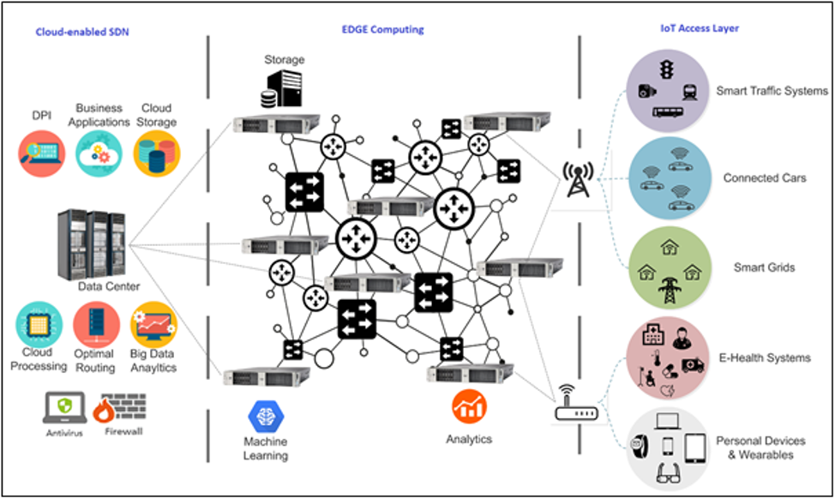

Slide 21
Proposed Solution(cont.)
FLOWCHART of Working of DRL methods in edge computed nodes
Start Execution
Collect Data for some time from nodes and observe the pattern
Choose a Reinforcement Learning Algorithm
Real-time decision making with self learning nodes
Deploying Trained Model
Train Reinforcement Learning Model
Periodic Evaluation
Define State Space, Action Space and Reward Space
Notes:
https://thomassimonini.medium.com/an-introduction-to-deep-reinforcement-learning-17a565999c0c
https://medium.com/geekculture/introduction-to-deep-reinforcement-learning-268ebd44b23

Slide 22
FUTURE WORK and Challenges
Practical implementation of the proposed idea on an edge computing based SDN-IoT network.
An optimized deep reinforcement learning algorithm that can be implemented on edge nodes which can improve QoS parameters and provide us with improved parameters every time.
Keep on looking for methods other than reinforcement learning and choosing from them if they are better than current implementation.
Scalability is a concern as the number of edge devices and IoT devices increases. Developing scalable DRL solutions that can handle large-scale deployments is a challenge.
Investigate hybrid approaches that combine traditional optimization methods with DRL to leverage the strengths of both. This can enhance the adaptability and efficiency of the system.

Slide 23
Conclusion
Reinforcement Learning is very useful way of improving QoS parameters and is a domain of great importance.
Reinforcement learning can work in such a way that it can be implemented on edge nodes as well as on SDN controllers to provide much reduced latency and power of real time decision making.

Slide 24
Tools identified
While there might not be specific tools designed exclusively for this integration, we can use a combination of existing tools to simulate and study these systems.
ONF(Open Network Operating System): ONOS is an open-source SDN operating system designed to manage and control SDN networks. It can be extended to include edge computing components and integrate with IoT devices.
MiniNet: Mininet is a network emulator that allows you to create a realistic network topology on a single machine. It's commonly used for SDN testing and development. You can set up an SDN environment using Mininet and integrate RL agents to observe their behavior in an SDN setting.

Slide 25
References
Ja’afreh, M., Adhami, H., Alchalabi, A.E. et al. Toward integrating software defined networks with the Internet of Things: a review. Cluster Comput 25, 1619–1636 (2022). https://doi.org/10.1007/s10586-021-03402-4
Jazaeri, S.S., Jabbehdari, S., Asghari, P. et al. Edge computing in SDN-IoT networks: a systematic review of issues, challenges and solutions. Cluster Comput 24, 3187–3228 (2021). https://doi.org/10.1007/s10586-021-03311-6
Wu, Y. Auto scheduling through distributed reinforcement learning in SDN based IoT environment. J Wireless Com Network 2023, 102 (2023). https://doi.org/10.1186/s13638-023-02314-8
R. S. Alonso, J. Prieto, F. d. La Prieta, S. Rodríguez-González and J. M. Corchado, "A Review on Deep Reinforcement Learning for the management of SDN and NFV in Edge-IoT," 2021 IEEE Globecom Workshops (GC Wkshps), Madrid, Spain, 2021, pp. 1-6, doi: 10.1109/GCWkshps52748.2021.9682179.

Slide 26
Problem Statement
To improve data transmission in SDN-IoT networks with respect to latency and bandwidth via Network Slicing

Slide 27
INTRODUCTION
Network Slicing: A technology to divide our network into multiple virtual networks from a single shared physical network infrastructure
Being used in 5G networks
"Slicing enables service providers to create a variety of network slice architectures that deliver meaningful guarantees to customers regarding, say, a minimum amount of throughput for their connections or priority delivery of packets from specific types of devices or applications."[1]

Slide 28
Related work
Paper and Year | Advantages | Disadvantages
The 5G network slicing using SDN based technology for managing network traffic (2021) | Detailed Explanation on criterions behind different types of slices | Explained for 5G networks
Efficient Network Slicing with SDN and Heuristic Algorithm for Low Latency Services in 5G/B5G Networks (2023) | Implemented a heuristic scaling algorithm for Low Latency Services | Achieves only URLLC in 5G backhaul networks

Slide 29
Proposed Solution
Dynamically Allocating resources to network slices using a Predictive Algorithm
STEP 1: Identifying key parameters for slicing for different services
STEP 1I: Data Collection and Preprocessing
i. Setting up data collection mechanisms to gather historical data, can be done using Netflow Collectors, Custom Scripts and APIs
ii. Preprocess the data to make sure that it is suitable for Predictive Modelling
Netflow is a feature by CISCO for collecting IP traffic information and monitoring network flow.

Slide 30
PROPOSED SOLUTION(CONT.)
STEP III: Feature Engineering and Predictive Algorithm Development
i. Extracting only the necessary features from data collected. Features necessary may include Flow Duration, Packet Count and Byte Count, Protocol, Time of Day, Traffic Volume Distribution, Average Packet Size
ii. Selecting the appropriate algorithm for our data, some algorithm that might suit this problem include Random Forest Regressors and Gradient Boosting Regressors like XGBoost and LightGBM
EXAMPLE:
Features (X):
  Source IP, Destination IP, Protocol, Packet Count, Byte Count, Port Numbers etc.
Target (y):
  Latency values for each corresponding network flow.

Slide 31
PROPOSED SOLUTION(CONT.)
STEP IV: Model Training and Validation
i. Split the collected data into training and validation sets
ii. Train the predictive model using historical data and validate its accuracy
STEP V: Real Time Prediction
i. Use the trained model to make real-time predictions based on incoming NetFlow Data

Slide 32
Proposed solution(Cont.)
STEP VI: Slice Creation and Management
i. Configure the SDN controller to create and manage slices based on predicted demands. This includes using APIs / Controller Interfaces to create and define network slices based on the predicted demands and allot resources accordingly.
ii. Implement QoS policies within SDN framework: Defining thresholds/ranges for each QoS parameter

Slide 33
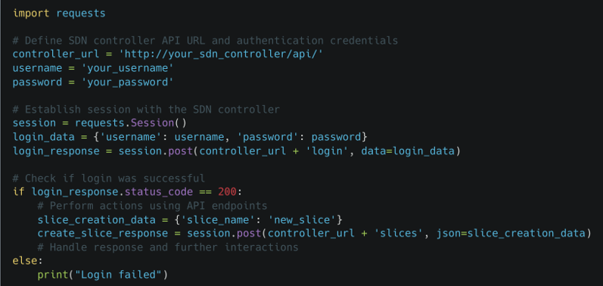
Proposed Solution(Cont.)

Slide 34
Proposed solution(cont.)
STEP VII: Monitoring and Optimisation
i. Deploy monitoring tools to track network performance and slice characteristics.
ii. Continuously optimize slice configurations and resource allocations based on real-time feedback.

Slide 35
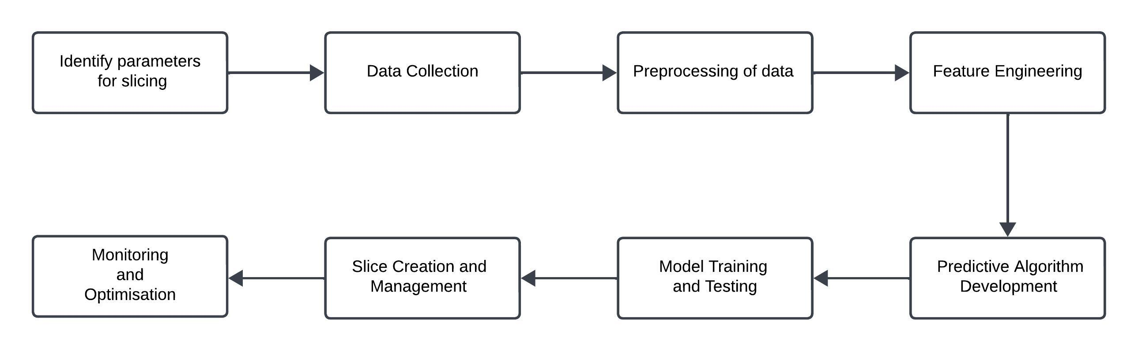
Proposed Solution(Cont.)

Slide 36
PROPOSED solution(cont.)
BENEFITS:
Efficient Resource Allocation: Predictive algorithms enable proactive allocation of resources, ensuring that each slice receives the necessary resources based on anticipated demands. This minimizes resource wastage and maximizes utilization.
Tailored Service Levels: Predictive insights allow for the customization of Quality of Service (QoS) parameters within each slice, ensuring that specific performance criteria are met, such as low latency, high bandwidth, or minimal packet loss.
Optimized Infrastructure Usage: By precisely allocating resources as per predicted demands, there's a reduction in unnecessary overprovisioning, leading to cost savings in terms of infrastructure and operational expenses.

Slide 37
Tools identified
Data Collection: PRTG Network Monitor capture and analyse network traffic to extract flow data for predictive analytics.
Data Processing: Pandas and NumPy for data manipulation, Scikit-learn and TensorFlow for building predictive models.
SDN Controllers: OpenDaylight provide APIs and interfaces to manage SDN networks.
Real-time Monitoring Solutions: Grafana offers real-time monitoring capabilities, enabling adjustments based on live network conditions.
Simulation Tools: Mininet helps simulate network environments for testing and validation before deployment.

Slide 38
Conclusion
Implementing network slicing with predictive algorithms empowers adaptable, efficient, and responsive networks. By leveraging predictive insights, SDN slices are tailored for optimal resource allocation and QoS fulfilment.
FUTURE WORKS:
Find out how this predictive modelling can be used in real time and allot resources accordingly. Implementing this in real life to find out if it works as per the demand.

Slide 39
References
Inağ, Yasin & Demirci, Mehmet & Ozdemir, Suat. (2019). "Implementation of an SDN Based IoT Network Model for Efficient Transmission of Sensor Data". 10.1109/UBMK.2019.8907119.
Daifallah Alotaibi, Vijey Thayananthan, Javad Yazdani, The 5G network slicing using SDN based technology for managing network traffic, Procedia Computer Science, Volume 194, 2021
Botez R, Pasca AG, Sferle AT, Ivanciu IA, Dobrota V. Efficient Network Slicing with SDN and Heuristic Algorithm for Low Latency Services in 5G/B5G Networks. Sensors (Basel). 2023 Jun 30;23(13):6053. doi: 10.3390/s23136053. PMID: 37447902; PMCID: PMC10346795.

Slide 40
Problem statement
To improve the performance of flow space distribution in SDN-enabled fog computing for enhanced IoT application performance.

Slide 41
Mitigating the Challenges of Traditional Cloud Services for IoT: Leveraging Fog Computing (FC) and Software-Defined Networking (SDN) for Real-time Communication and Efficient Flow Space Management.
We're dealing with a problem where regular cloud services aren't cutting it for IoT needs, which require quick communication and movement support
Fog Computing (FC) brings cloud capabilities closer to IoT devices, but we still face issues with delays, limited bandwidth, and how we manage data flow
The set-up of traditional fog networks causes unavoidable delays and problems like dropped packets. To fix this, we need Software-Defined Networking (SDN) and distribution schemes
It gives us flexibility to manage data flow better, reducing delays, and ultimately improving the quality of service at the network's edge

Slide 42
PROPOSED SOLUTION
Assigning Dynamic priority classes – Adjusting priority classes dynamically
Adaptive Flow space allocation – Adapting ML or RL for adaptive flow
Hierarchical Flow space partitioning – priority-based allocation – adaptive scheduling
QoS Aware Admission control
Time sensitive packet handling
Hybrid SDN-FC Architecture – Dynamic Resource Allocation
Cross-layer communication

Slide 43
PROPOSED METHODOLOGY
PROPOSED METHODOLOGY : Dynamic prioritized Flow space Allocation (DPFSA)
set of QoS metrics that are critical for the performance -
Latency: The time it takes for data to travel from source to destination
Packet Loss: The percentage of packets that do not reach their destination
Bandwidth Utilization: The amount of network bandwidth being used at a given time
Monitoring Real-time QoS Metrics
Evaluating the priority based on QoS Metrics
Adjusting Priority classes dynamically :
  Can be achieved by leveraging historical data or machine learning models
  The adjustment logic involves analysing past performance metrics, such as latency, packet loss, and bandwidth utilization, to identify patterns and trends
  Based on this analysis, the system can dynamically adapt priority classes by assigning higher priority to specific traffic types or adjusting thresholds to meet changing network conditions
Assigning computed priority to Network Traffic for subsequent processing or resource allocation

Slide 44
PROPOSED METHODOLOGY (cont.…)
Adaptive Flow space Allocation :
  Adaptive Flow space Allocation with machine learning :
    (Data collection): Collecting historical data on network traffic patterns, including flow space usage, application demands, and performance metrics
    (Feature engineering): Extracting relevant features from the historical data, such as time-of-day patterns, application types, and network conditions
    (Model training): Training a machine learning model (e.g., regression) to predict future flow space requirements based on the extracted features
    (Real time prediction): Using the trained model to predict current and future traffic patterns in real-time
    (Dynamic adjustment): Dynamically adjusting flow space allocation based on the predicted demand, optimizing for current and anticipated network conditions
  Adaptive Flow space Allocation with Reinforcement learning :
    Reinforcement learning is designed to handle temporal dependencies in sequential decision-making
    (Exploration-Exploitation Tradeoff) : Reinforcement learning balances exploration and exploitation, essential in networking where adapting to unforeseen traffic patterns (exploration) while optimizing for known conditions (exploitation) is crucial

Slide 45
PROPOSED METHODOLOGY (contD.)
HIERARCHICAL FLOW SPACE PARTITIONING:
  Defining priority classes (e.g., Critical, High, Medium, Low) and allocating corresponding layers of the flow space. Higher-priority classes receive larger portions, ensuring preferential treatment for critical packets
  Utilizing adaptive scheduling algorithms (e.g., Deficit Round Robin) to dynamically allocate bandwidth within each layer. This ensures efficient resource utilization and responsiveness to varying application demands
  Algorithms assess network conditions and adjust the size of flow space layers to optimize for changing traffic patterns
QOS AWARE ADMISSION CONTROL:
  (Real-Time Network Load Monitoring): Employing real-time network load monitoring mechanisms to continuously assess current traffic conditions. Utilizing protocols like SNMP or NetFlow to gather data on bandwidth usage, latency, and packet loss
  (Dynamic Thresholds for Admission): Setting dynamic admission thresholds based on the current network load. Higher-priority classes may have lower admission thresholds, allowing them to be prioritized during periods of increased traffic
  (Packet Classification and Marking): Deep Packet Inspection (DPI) or Layer 7 inspection to classify packets based on their content. Mark packets with appropriate priority tags, aiding in efficient admission control decisions
  (Protocol Support): Ensuring the compatibility with standard protocols such as RSVP (Resource Reservation Protocol) or DiffServ. Leverage these protocols for signaling and marking packets, facilitating end-to-end QoS

Slide 46
PROPOSED METHODOLOGY (cont.…)
(Queue Management) Employing advanced queuing mechanisms like Weighted Fair Queuing (WFQ) or Class-Based Queuing (CBQ) to manage packet queues based on priority. This helps prevent packet loss during periods of congestion
(Congestion Avoidance) Integrate congestion avoidance techniques, such as Random Early Detection (RED), to proactively manage congestion and prevent network degradation. Adjust admission policies dynamically based on congestion indicators
Time-Sensitive Packet Handling:
  Tagging critical packets with time-sensitive markers. This allows them to bypass regular processing queues, ensuring rapid processing and minimizing latency
  Time sensitive Marker - Utilizing the header tags or specific fields to indicate the time-sensitive nature of the packet
  Time-to-Live (TTL) extension for critical packets. Including an additional field in the packet header indicating the maximum time the packet can exist in the network. This time-sensitive marker ensures rapid processing and timely delivery
  Protocol Extension: Extending existing protocols (e.g., IP, TCP, UDP) or leverage application-layer protocols to include time-sensitive markers

Slide 47
PROPOSED METHODOLOGY (contD.)
Queue Bypass Mechanism:
  A specialized queue bypass mechanism for time-sensitive packets. When critical packets arrive, they are identified by the time-sensitive marker and directed to a fast-track processing queue, bypassing regular processing queues
  A Fast-Track Queue for time-sensitive packets. Upon arrival, critical packets are identified by the time-sensitive marker and directed to this dedicated queue, bypassing the regular processing queues
  This specialized queue ensures expedited handling for critical traffic
  Ensuring network-wide synchronization to maintain accurate timing for time-sensitive packet handling. This may involve synchronization protocols like Precision Time Protocol (PTP) to align clocks across network devices
Hybrid SDN-FC Architecture:
  Centralized Control with SDN: Utilizing SDN's centralized control plane to manage network-wide policies, resource allocation, and traffic engineering. A global SDN controller, possibly using OpenFlow, oversees the network's overall behaviour
  Edge Processing in Fog Computing (FC): Integrating Fog Computing at the network edge to handle distributed processing tasks and reduce latency
  Fog nodes, acting as local controllers, process data closer to the source, optimizing response times for time-sensitive applications

Slide 48
PROPOSED METHODOLOGY (contD.)
SDN-Fog Interface: Establishing a well-defined interface between the SDN controller and Fog nodes.
Protocols like NETCONF or gRPC can facilitate communication, enabling the SDN controller to delegate tasks and receive updates from Fog nodes seamlessly
Employing the dynamic resource allocation approach to optimize the distribution of computing resources between the centralized SDN controller and distributed Fog nodes. This ensures efficient utilization based on workload characteristics
In the context of the proposed architecture, the dynamic resource allocation approach involves continuous monitoring of network conditions and workloads, and the centralized SDN controller makes on-the-fly adjustments to allocate computing resources optimally across distributed Fog nodes
This ensures that resources are efficiently utilized, providing responsiveness, scalability, and adaptability to varying demands within the network
Employ service orchestration frameworks, such as Kubernetes or Docker Swarm, to manage the deployment and scaling of services across both SDN and Fog nodes. This enables flexible and scalable service delivery

Slide 49
PROPOSED METHODOLOGY (contd.)
Cross-layer Communication:
  Standardized communication interface between the SDN controller and Fog nodes. This interface should encapsulate information exchange protocols, ensuring a clear and interoperable cross-layer communication framework
  Protocol Selection: RESTful APIs, MQTT (Message Queuing Telemetry Transport), CoAP (Constrained Application Protocol), or gRPC (gRPC Remote Procedure Calls)
  API Design: Application Programming Interface (API) that specifies how the SDN controller and Fog nodes should communicate
  Message Format: JSON or Protocol Buffers to ensure compatibility and ease of parsing on both ends
  Command Structure: defining the structure of commands or requests that the SDN controller can send to Fog nodes
  Response Handling: Specifying the expected format of responses from Fog nodes to the SDN controller and clearly defining success and error response structures, including status codes and relevant data payloads
  Transport Layer Security (TLS): This encrypts the communication channel, protecting sensitive information during transit

Slide 50
PROPOSED METHODOLOGY (cont.)
  Enabling the SDN controller to issue commands to Fog nodes through the communication interface. Commands may include flow space allocation adjustments, service deployment, or real-time updates based on network conditions
  Implementing event-driven communication to enable instant responses to changes in network conditions.
  Events such as traffic spikes, resource shortages, or node failures trigger immediate communication and adjustment actions between the SDN controller and Fog nodes
Event Definition: Defining a set of events that can impact network conditions
    Event Monitoring: real-time monitoring of traffic patterns, resource usage, and node health
    Event Notification System: system that enables Fog nodes to promptly notify the SDN controller when a predefined event occurs
    Event Payload: context for the SDN controller to understand the nature and impact of the event
    Webhooks (Optional): webhooks for instant communication
    SDN Controller Event Handler: component that listens for incoming event notifications and process
  Deploying network synchronization protocols, such as Precision Time Protocol (PTP) or Network Time Protocol (NTP), to align clocks across SDN and Fog nodes. Synchronized timing is crucial for coordinating actions and ensuring accurate decision-making

Slide 51
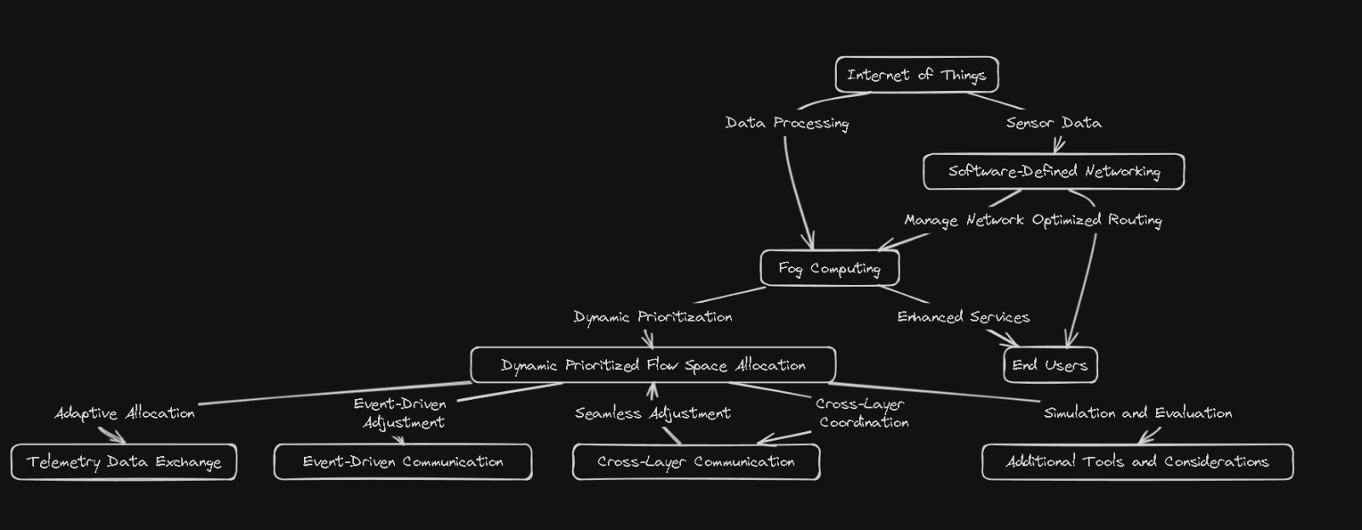

Slide 52
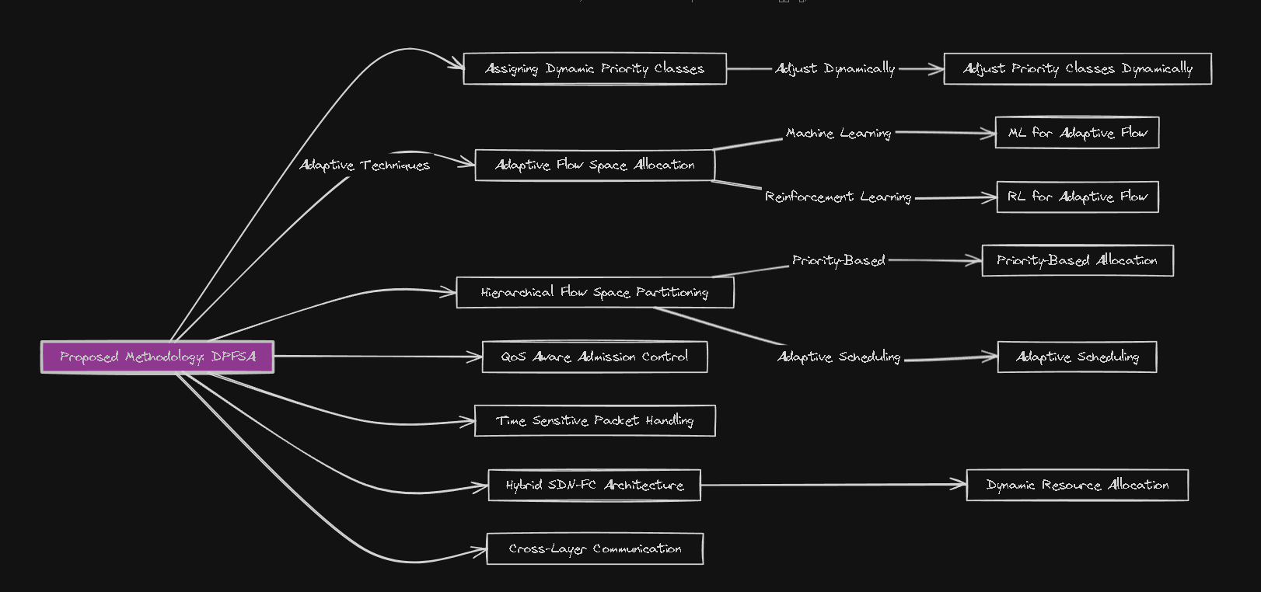

Slide 53
Tools identified
Simulation Tools : NS-3, Mininet, or OMNeT++
Machine Learning Tools : TensorFlow or PyTorch
Security Tools : Wireshark
Network Monitoring : Nagios or Icinga
Visualization: Gephi or Matplotlib
Containerization: Docker
Orchestration : Kubernetes
Real-time Metrics Monitoring: Prometheus and Grafana

Slide 54
Conclusion and FUTURE WORKS
The proposed Dynamic Prioritized Flow Space Allocation (DPFSA) system demonstrates significant advancements in optimizing flow space distribution for enhanced IoT application performance
The integration of dynamic prioritization, adaptive allocation, and cross-layer coordination addresses existing challenges, fostering improved Quality of Service (QoS) parameters
Implementing this theoretical approach to testing with the tools and technologies identified, we can test how well it works with bigger networks and in different situations

Slide 55
references
Diro, A.A., Reda, H.T. & Chilamkurti, N. Differential flow space allocation scheme in SDN based fog computing for IoT applications. J Ambient Intell Human Comput (2018). https://doi.org/10.1007/s12652-017-0677-z
S. Goudarzi, M. H. Anisi, H. Ahmadi and L. Musavian, "Dynamic Resource Allocation Model for Distribution Operations Using SDN," in IEEE Internet of Things Journal, vol. 8, no. 2, pp. 976-988, 15 Jan.15, 2021, doi: 10.1109/JIOT.2020.3010700.
K. T. Selvi and R. Thamilselvan, "Dynamic Resource Allocation for SDN and Edge Computing based 5G Network," 2021 Third International Conference on Intelligent Communication Technologies and Virtual Mobile Networks (ICICV), Tirunelveli, India, 2021, pp. 19-22, doi: 10.1109/ICICV50876.2021.9388468.
Abdukodir Khakimov, Abdelhamied A. Ateya, Ammar Muthanna, Irina Gudkova, Ekaterina Markova, and Andrey Koucheryavy. 2018. IoT-fog based system structure with SDN enabled. In Proceedings of the 2nd International Conference on Future Networks and Distributed Systems (ICFNDS '18). Association for Computing Machinery, New York, NY, USA, Article 62, 1–6. https://doi.org/10.1145/3231053.3231129

